Slide 1




4-Bit Binary-to-Decimal Conversion
& Display System Using Logic Gates
A complete hardware synthesis converting 4-bit binary inputs (0000–1111) to decimal outputs (0–15) driven on a 7-segment display.
PRESENTED BY:
Charan (Roll Number : 2620030058)
Shashank (Roll Number: 2620030057)
Harini (Roll Number: 2620030050)
Meghana (Roll Number: 2620030053)

Slide 2












System Objective & Applications
Core Objectives
Current State Output Example
Accept a 4-bit binary input combination (0000 to 1111).
Convert the input binary value into its decimal equivalent (0 to 15).
Drive and display the decimal number dynamically on a 7-segment display module.
Binary Input: 1010 → Decimal: 10
Digital Meters
Counters
Embedded Systems
Calculators
Real-time measurement readout units in voltage and current meters.
Sequential event counters for industry timing and frequency modules.
Arithmetic processing output stages in digital calculation units.
Low-cost visual status displays in microcontroller projects.

Slide 3







System Architecture & Overview
4-BIT BINARY INPUT
BINARY-TO-DECIMAL
4-BIT DECIMAL OUTPUT
7-SEGMENT DRIVER
7-SEGMENT DISPLAY
A, B, C, D (MSB to LSB)
Weighted Sum Logic
BCD Decoder Circuit
Visual Output
0 to 15 Equivalent
Key Theoretical Concept
A 4-bit binary number can represent 24 = 16 distinct values (0 to 15). These values correspond directly to decimal equivalents, converted through combinational logic gates to power designated segments on the readout display.

Slide 4







Circuit Design & Weighting Logic
Conversion Mathematical Model
Bit Weight Allocations
In standard positional binary notation, each bit carries a specific decimal weight:
Inputs act as a weighted sum feeding logic gates.
A (MSB)
B
Combinational network resolves binary values 0–15.
C
D (LSB)
Output drives segment activation patterns on display.

Slide 5



7-Segment Display (Common Cathode)
Control Mechanism
Each individual segment (a–g) is selectively toggled high by the logic gate matrix based on the input code.
Common cathode topology connects segment cathodes to ground (0V), activating segments when logic 1 is applied.
Conversion Example
Binary: 1010 → Decimal: 10 → Segment Activation → Display "10"
Segments: a, b, c, d, e, f, g

Slide 6

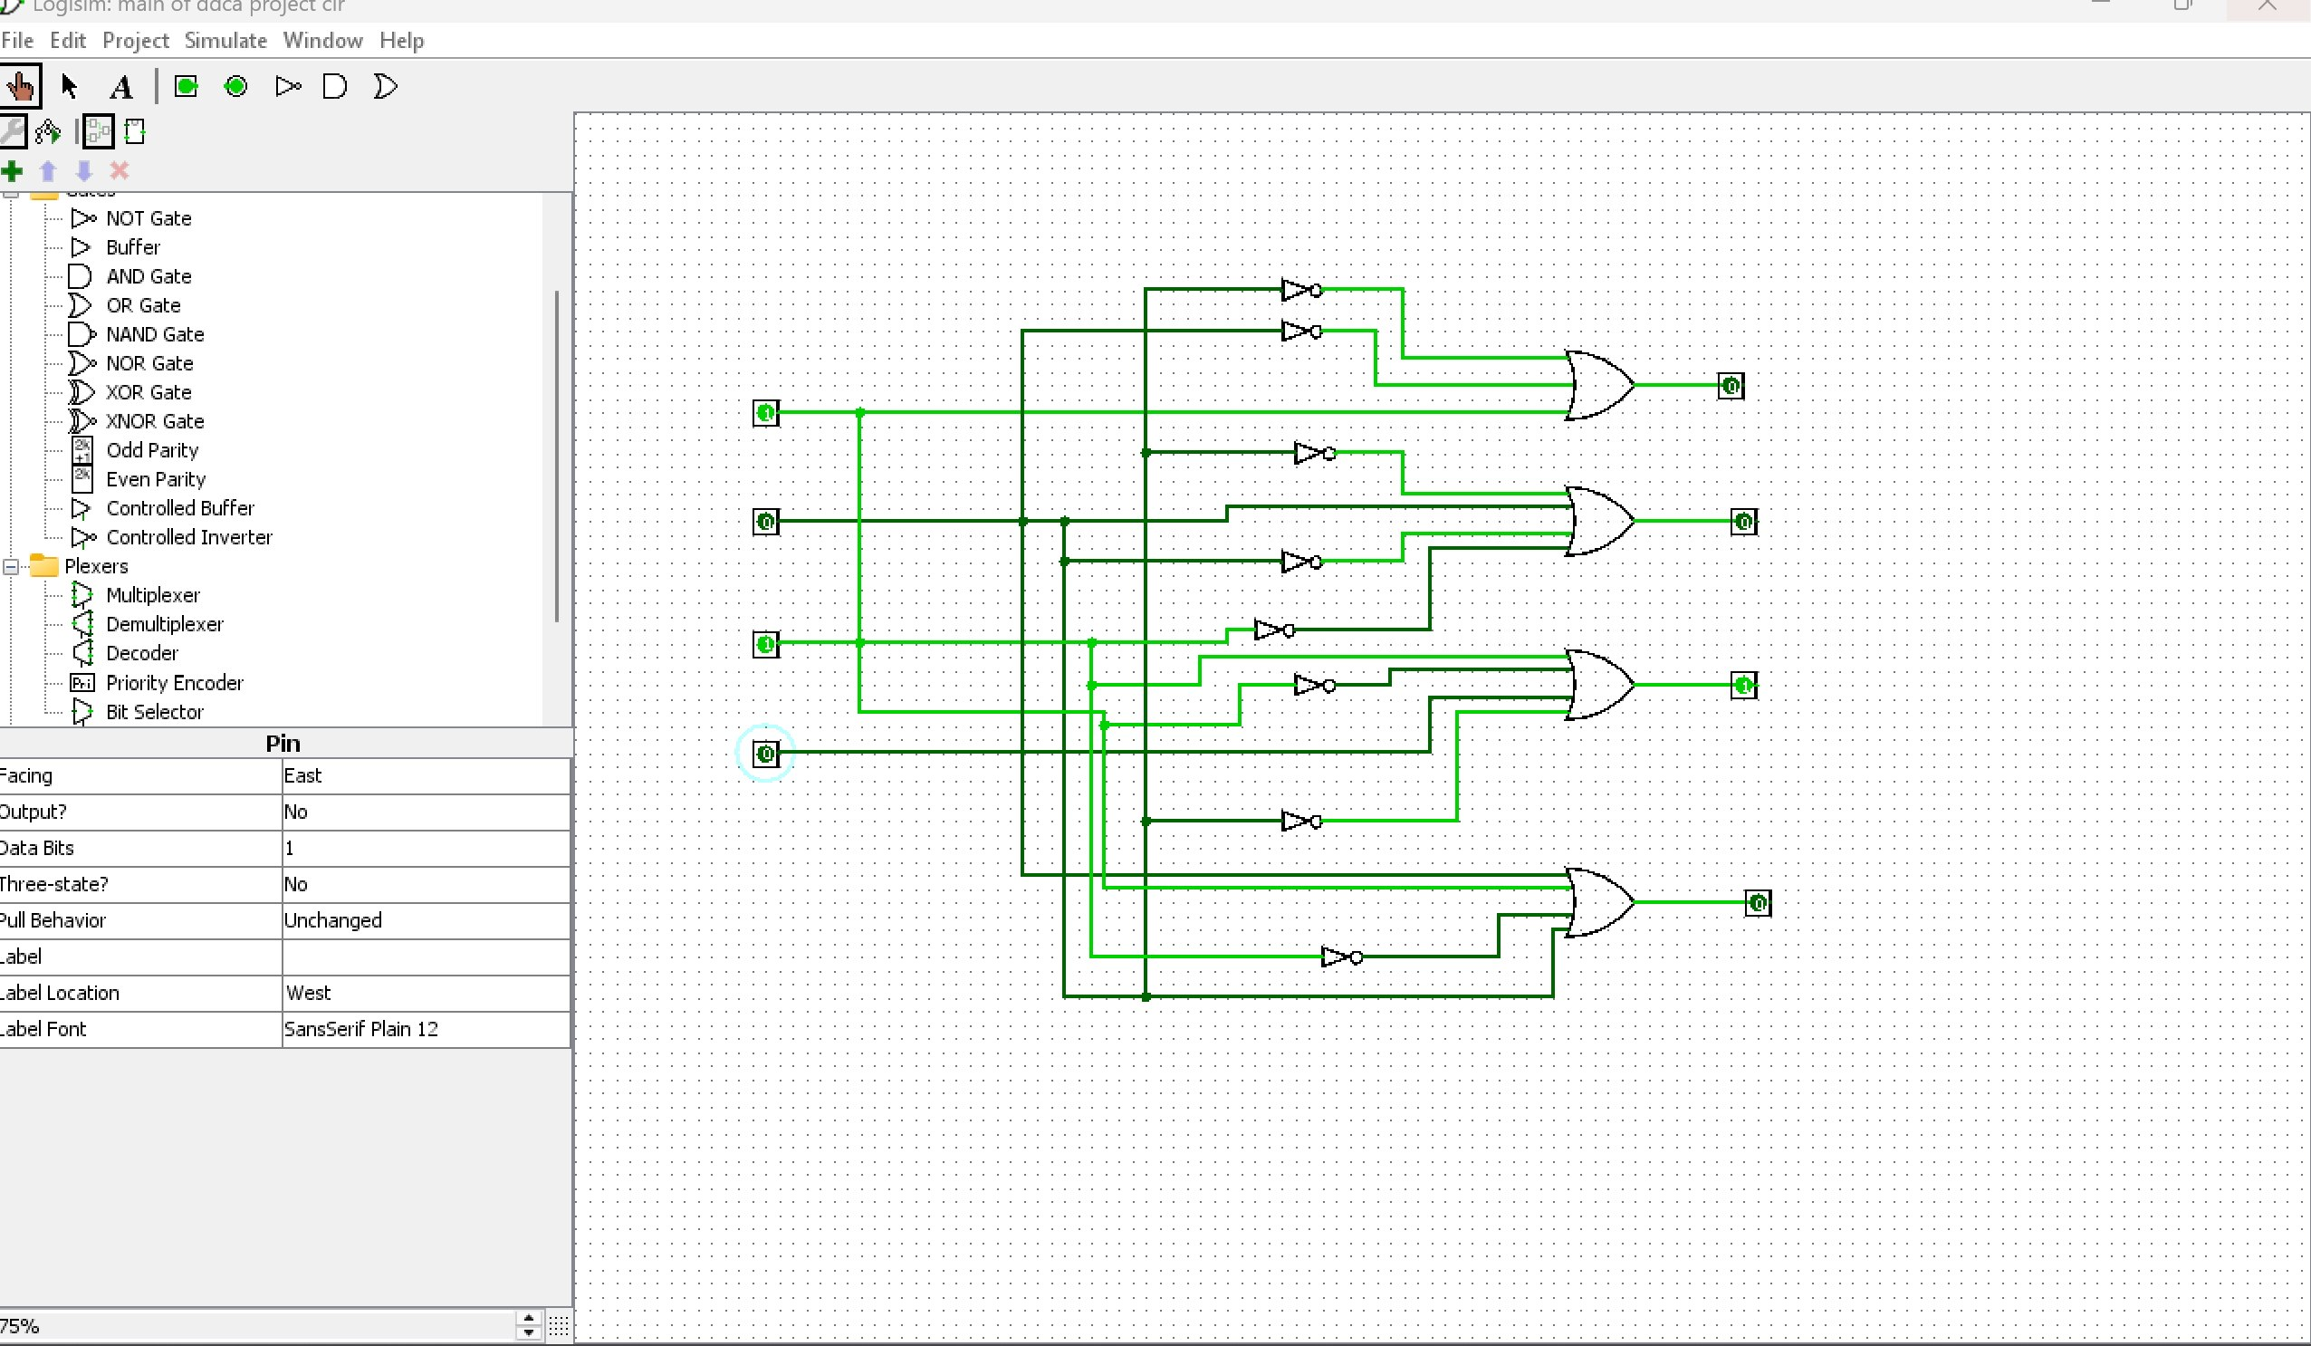


Circuit Construction in Logisim
Verification Result: Fully validated logic gate schematic for binary-to-decimal decoding.

Slide 7





4 Key Takeaways
Positional Binary Weighting
Combinational Gate Synthesis
Digital conversion relies on bit weights (8-4-2-1), summing binary values directly into decimal representations (0–15).
AND, OR, and NOT logic gate networks seamlessly map 4-bit binary states into corresponding segment drive signals.
7-Segment Display Integration
Complete Hardware Verification
Common cathode 7-segment display drivers transform logical high/low outputs into intuitive visual human-readable numbers.
Logisim schematic simulation confirms 100% accuracy across all 16 input combinations from 0000 (0) to 1111 (15).

Slide 8

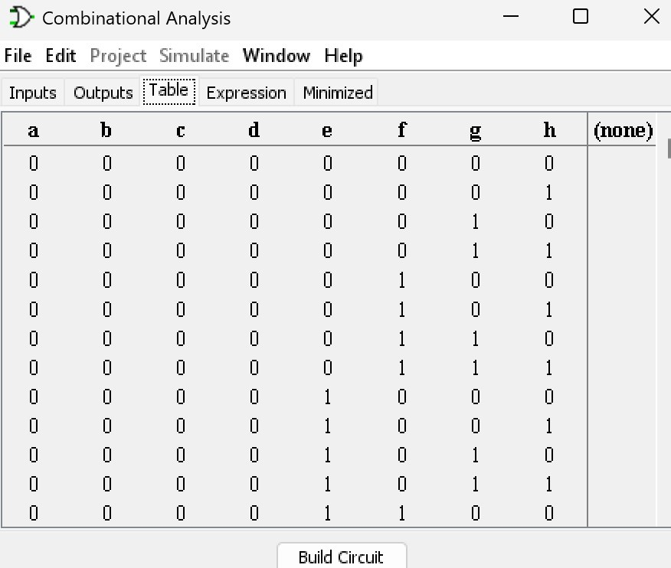

Thank You!
Digital Logic Design Lab
Logisim Implementation

Slide 9

Image Sources
https://png.pngtree.com/thumb_back/fw800/background/20260126/pngtree-futuristic-digital-circuit-board-with-glowing-neon-light-and-data-visualization-image_21025310.webp
Source: pngtree.com

